Slide 1


IMAGE EDITOR using python
Younis Ali
Bachelor of Electrical Engineering
Sukkur IBA University
Sukkur IBA University Merit Quality Excellence 1

Slide 2
Table Of Contents
Libraries
Functions
Conditions
Tools
Conclusion
Table Of Contents
Sukkur IBA University Merit Quality Excellence 2

Slide 3
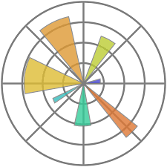
Introduction to libraries:
Matplotlib is a plotting library for the Python programming and its numerical mathematics extension NumPy. It provides an object-oriented API for embedding plots into applications using general-purpose GUI tools
Libraries
Sukkur IBA University Merit Quality Excellence 3

Slide 4

Introduction to libraries:
Python Imaging Library is a free and open-source additional library for the Python programming language that adds support for opening, manipulating, and saving many different image file formats
Libraries
Sukkur IBA University Merit Quality Excellence 4

Slide 5
functions :
Functions
Conditions
BASIC CODE:
def open_image(file_path):
image = Image.open(file_path)
return image
def display_image(image, title):
plt.imshow(image)
plt.axis('off')
plt.title(title)
plt.show()
Condition:
if original_image is not None:
display_image(original_image, 'Original Image')
# Example of applying some filters
bw_image = ImageOps.grayscale(original_image)
blur_image = original_image.filter(ImageFilter.BLUR)
sharpen_image = original_image.filter(ImageFilter.SHARPEN)
smooth_image = original_image.filter(ImageFilter.SMOOTH)
emboss_image = original_image.filter(ImageFilter.EMBOSS)
Functions
Sukkur IBA University Merit Quality Excellence 5

Slide 6
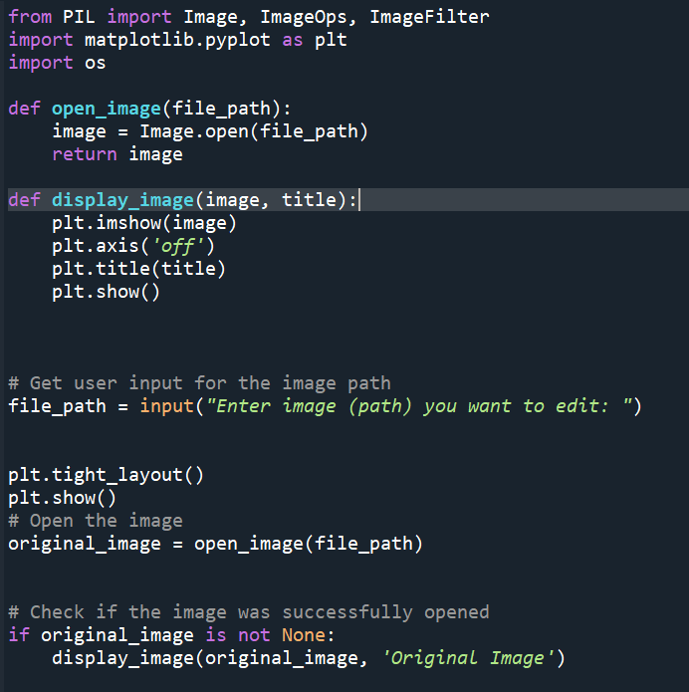
Complete Code
Sukkur IBA University Merit Quality Excellence 6

Slide 7
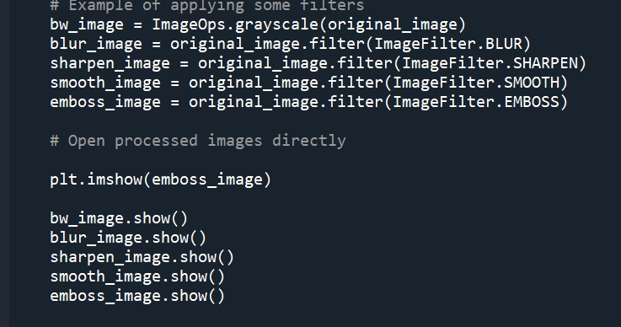
Complete Code
Sukkur IBA University Merit Quality Excellence 7

Slide 8
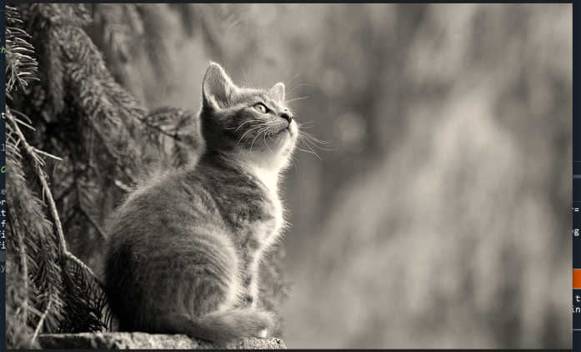
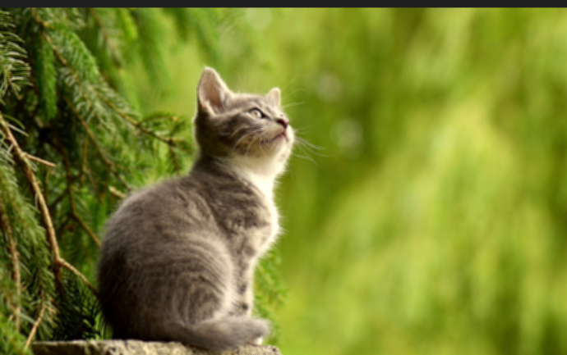
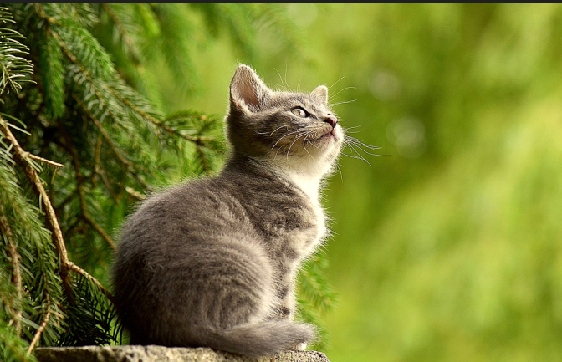
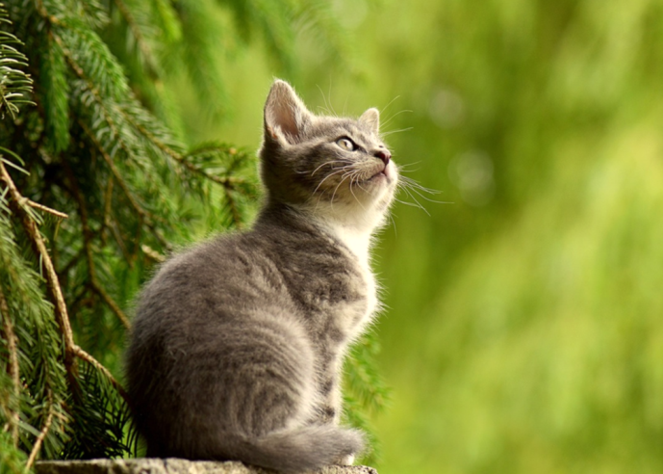
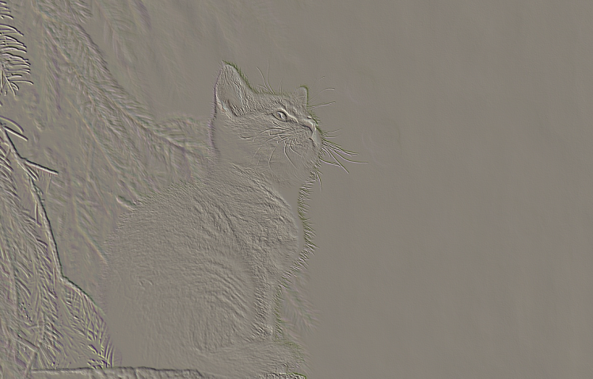
tools and views:
Your Image should be in your current directory
Tools and Views
bw_image.show()
blur_image.show()
sharpen_image.show()
smooth_image.show()
emboss_image.show()
Sukkur IBA University Merit Quality Excellence 8

Slide 9

Conclusion:
Photo editing can help make your social media posts more visually appealing and engaging.we can even use different filters ,change font size and do much more.
Example: ImageNet
Sukkur IBA University Merit Quality Excellence 9

Slide 10

Sukkur IBA University Merit Quality Excellence 10

